Slide 1

How Change Happens

Slide 2
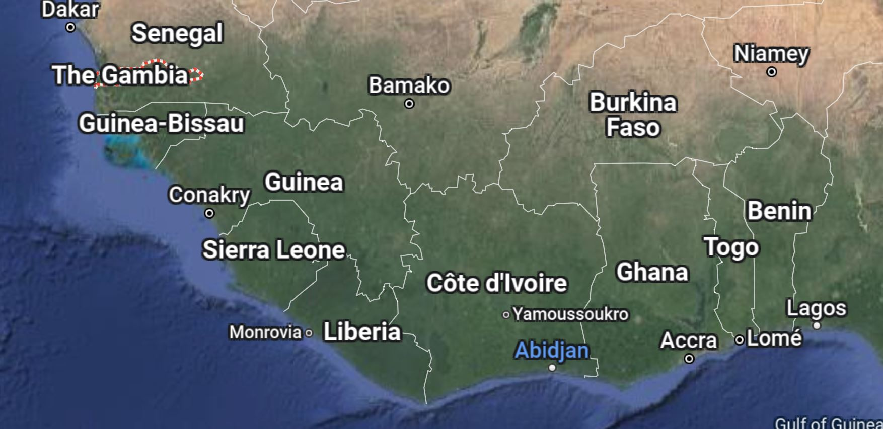
The Gambia: Africa’s smallest country

Slide 3
In 2000, 64.2% of Gambians could not read (i.e., literacy was 35.8%)
The British left an extensive school system, and the Catholic Church merged their schools with the government’s for a unified system which the Gambian government began expanding
By 2022, literacy had risen to 58.7%
But in the lowest income 20% of families, only 3% of girls were completing 12th grade.
And Islamic madrassas continued separately, focused on memorizing the Koran

Slide 4
Consequences of not educating girls
Early marriage
Traditionally, puberty was known as “marrying age”
More babies
Lower family incomes
Poorer children’s health
Not to mention the quality of life of the girls
This is why GambiaRising was created in 2011
By returned Peace Corps volunteers and staff

Slide 5
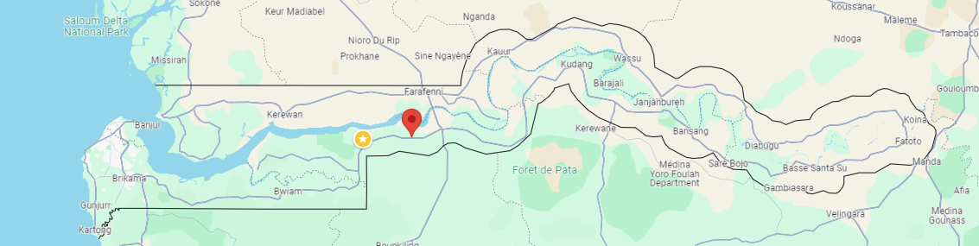
Massembeh village
in the Lower River Region

Slide 6
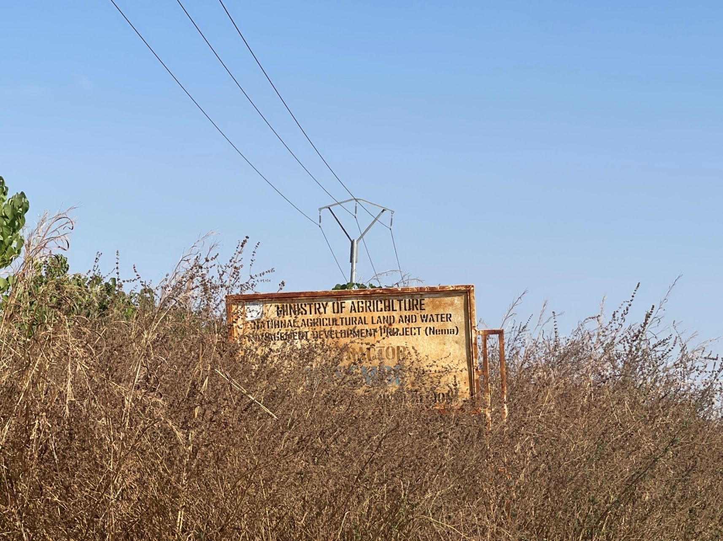
Massembeh is off the main road

Slide 7
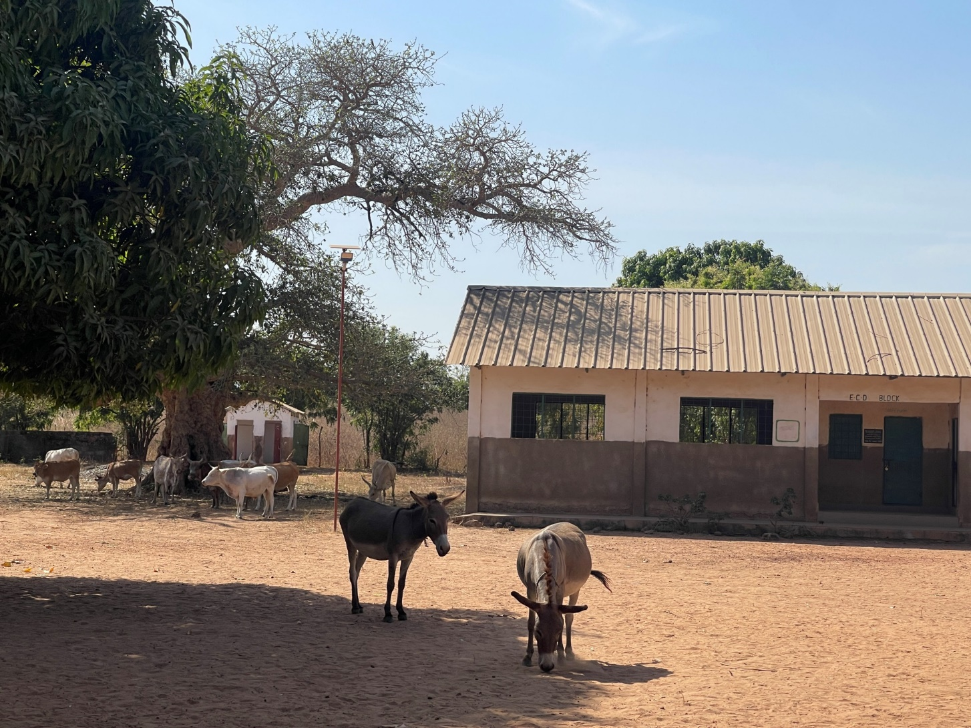
The school is beautiful

Slide 8
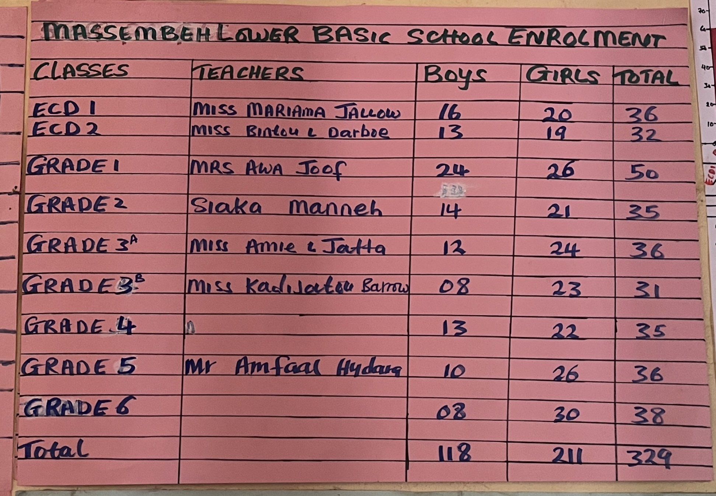
Of the 329 students, 211 are girls

Slide 9
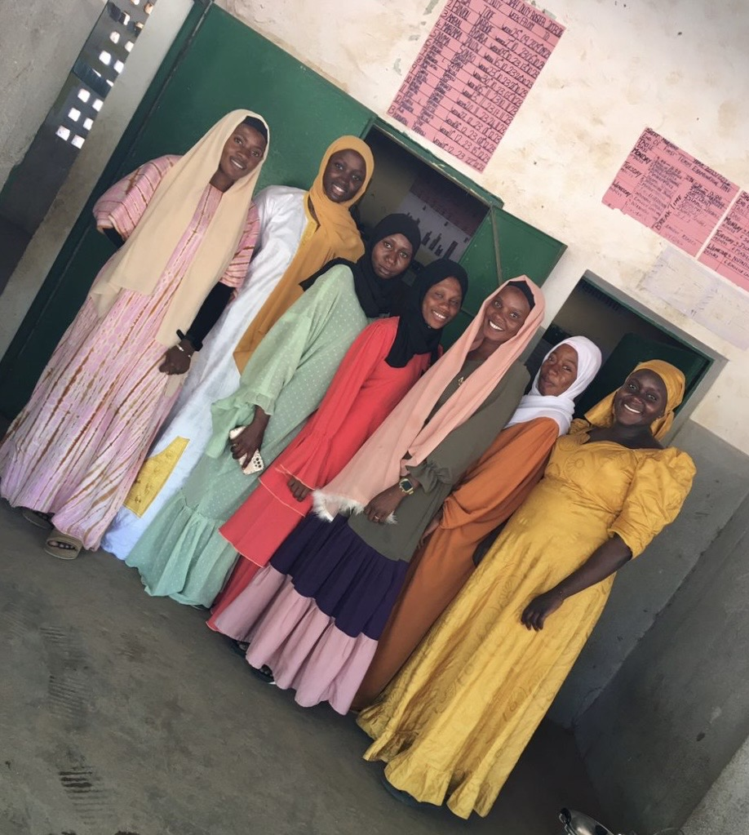
7 of the teachers are young women

Slide 10
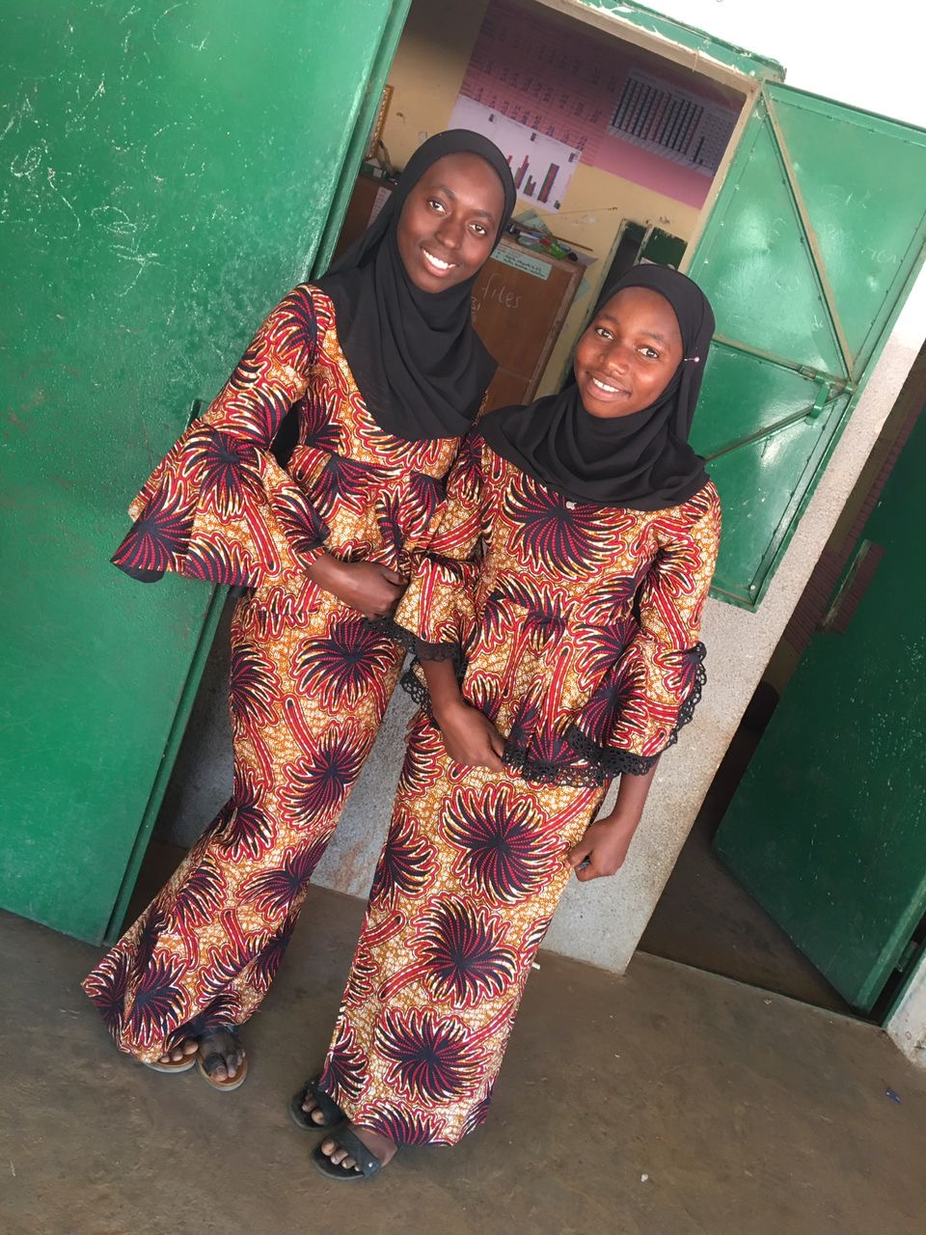
2 teachers in training are also women

Slide 11
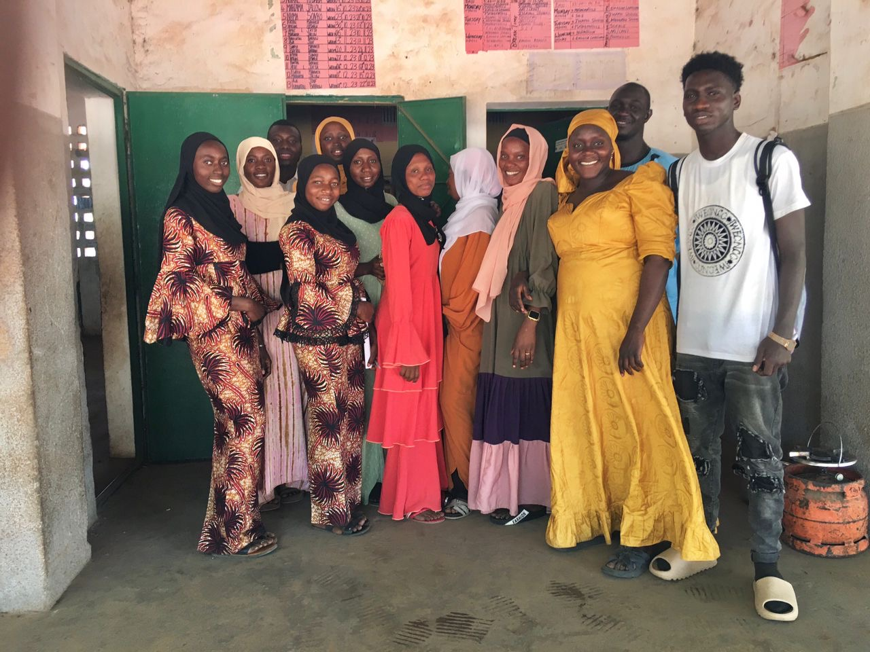
3 of 12 teachers are men

Slide 12
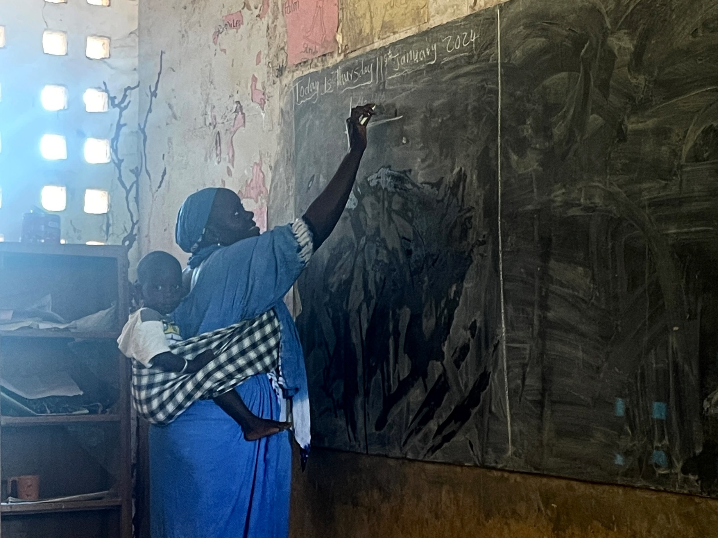
The women teachers are dedicated

Slide 13
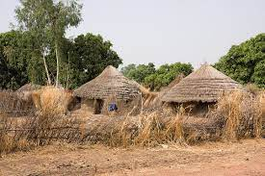
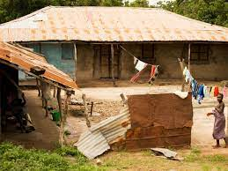
The Teachers’ Housing Problem

Slide 14
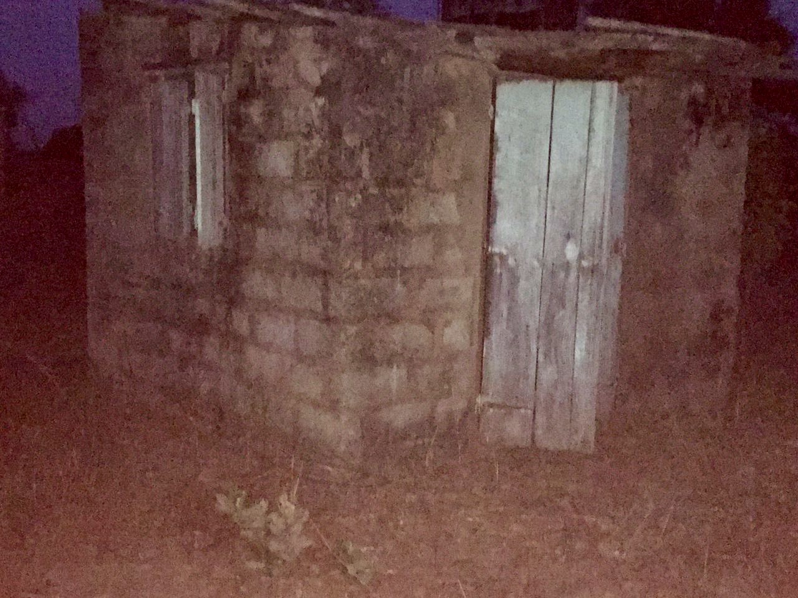
There was no housing for the teachers. Here is where 2 of the women lived:

Slide 15
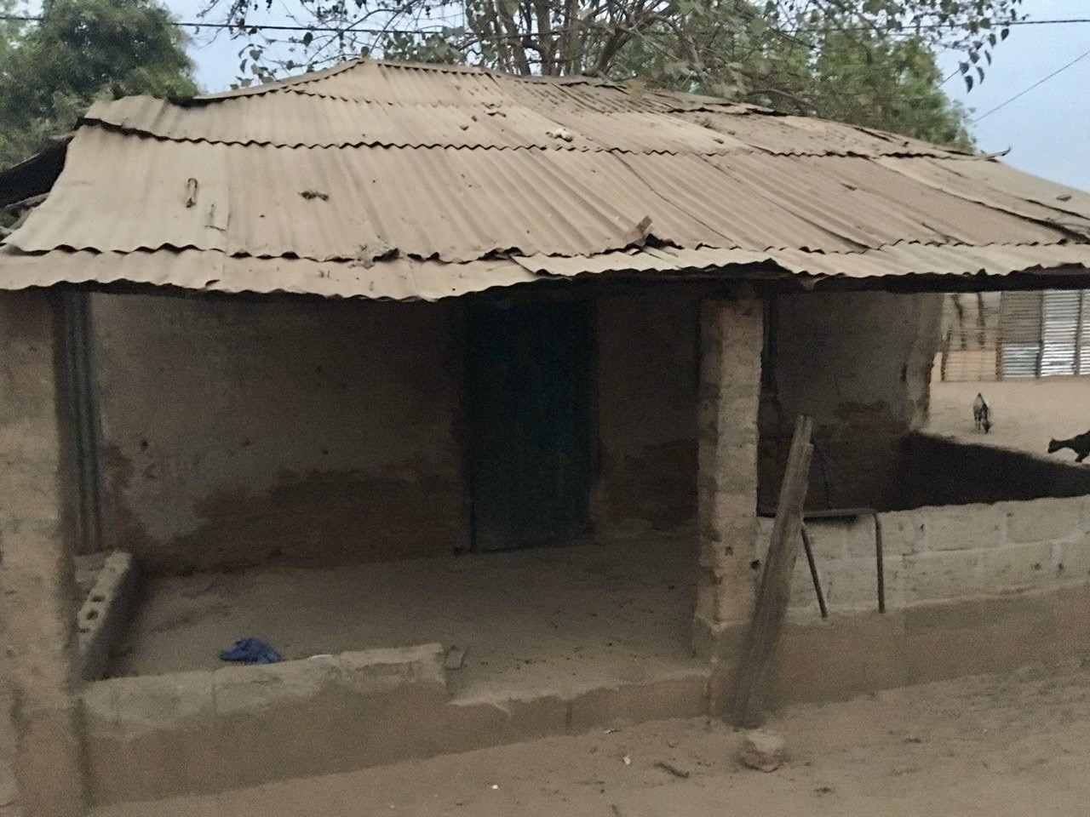
3 others lived here; there was only room for 2 beds

Slide 16
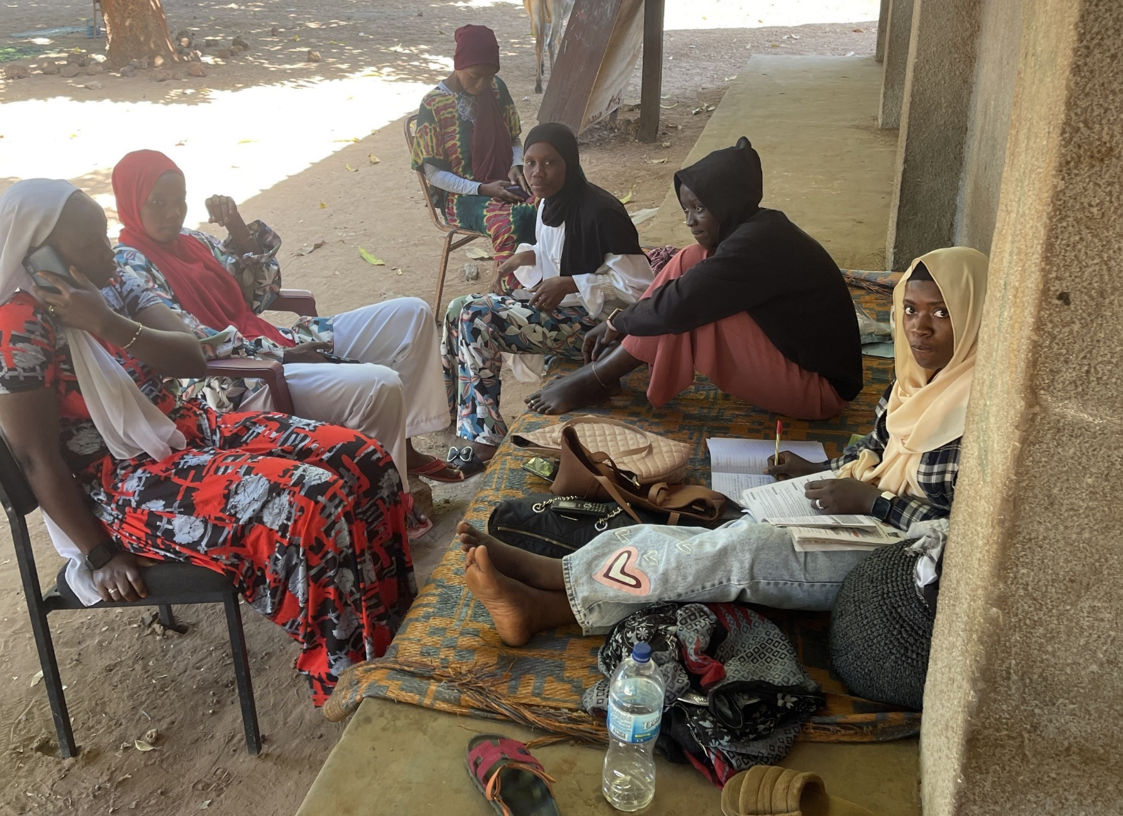
The women teachers stayed at the school until time for bed. All planned to transfer.

Slide 17
The community said they would build housing, if we could provide materials:
Housing units: 10 X $1500 = $15,000
Toilet/washrooms: 2 x $1250 = $2500
Optimum would be 1 teacher per room
With Concord Rotary backing, we started with 5 rooms, with 2 teachers sharing each room (and the men still sleeping in the village)
Work began.

Slide 18
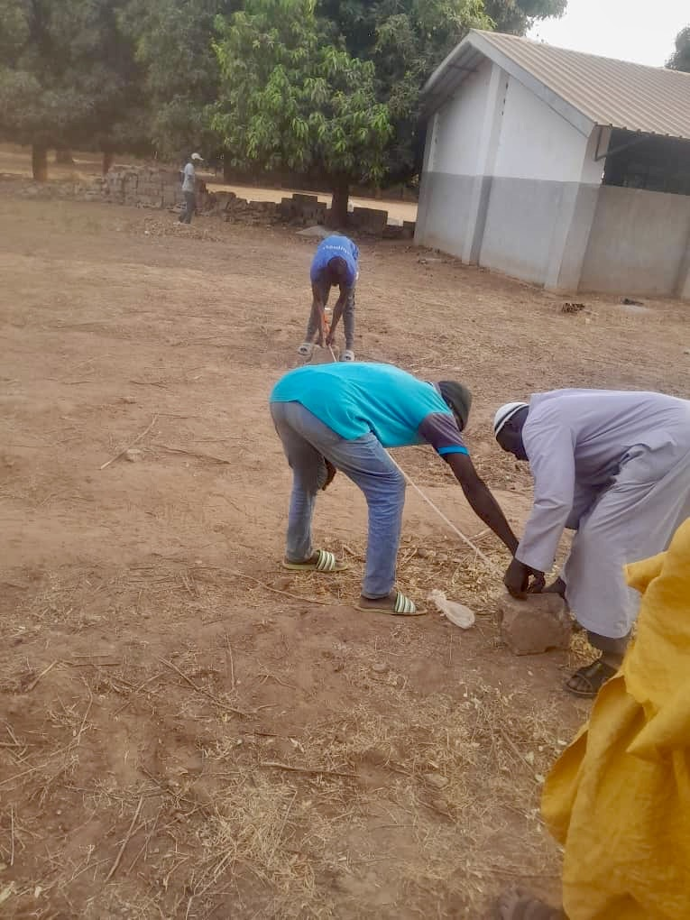
The plot was measured

Slide 19
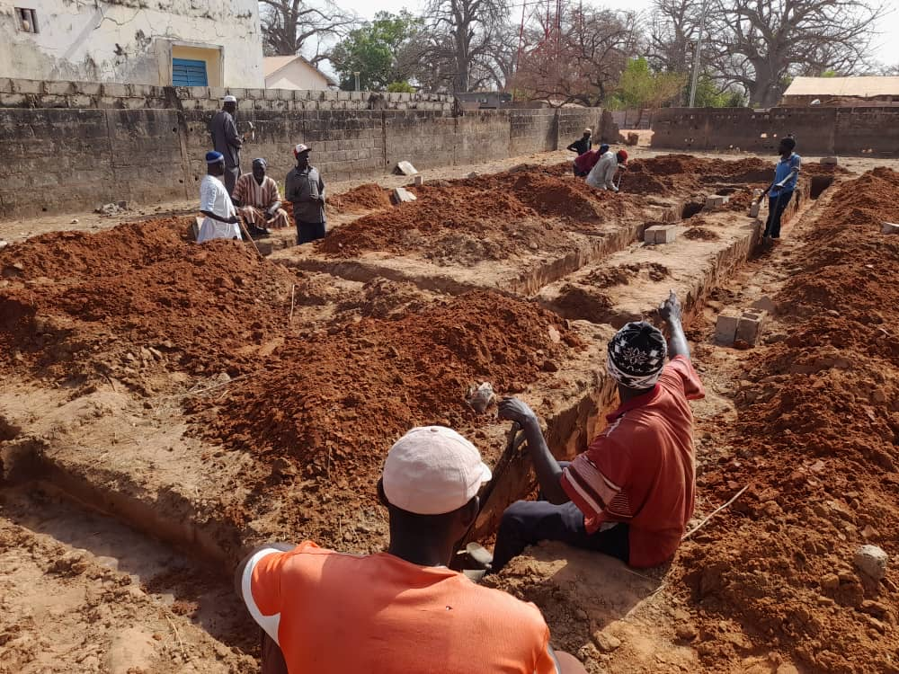
The community turned out

Slide 20
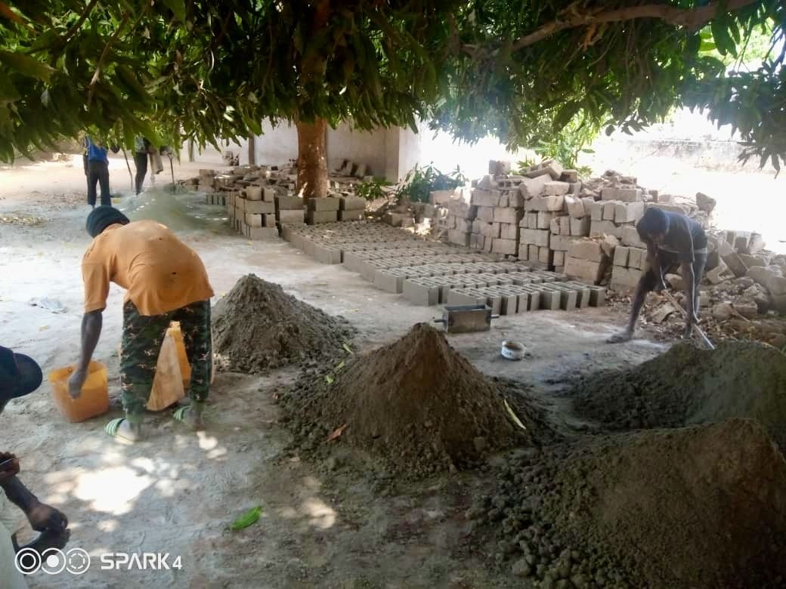
Bricks were made by hand

Slide 21
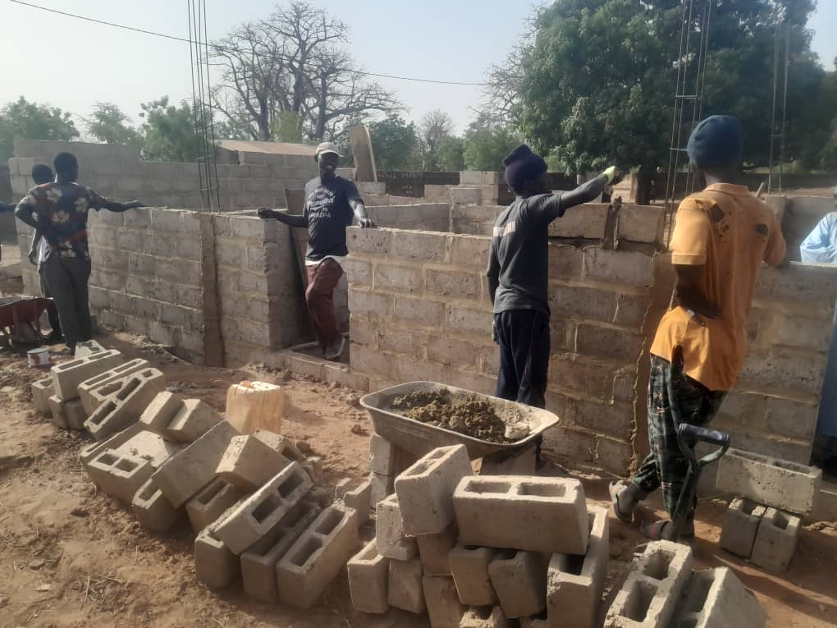
The walls went up

Slide 22
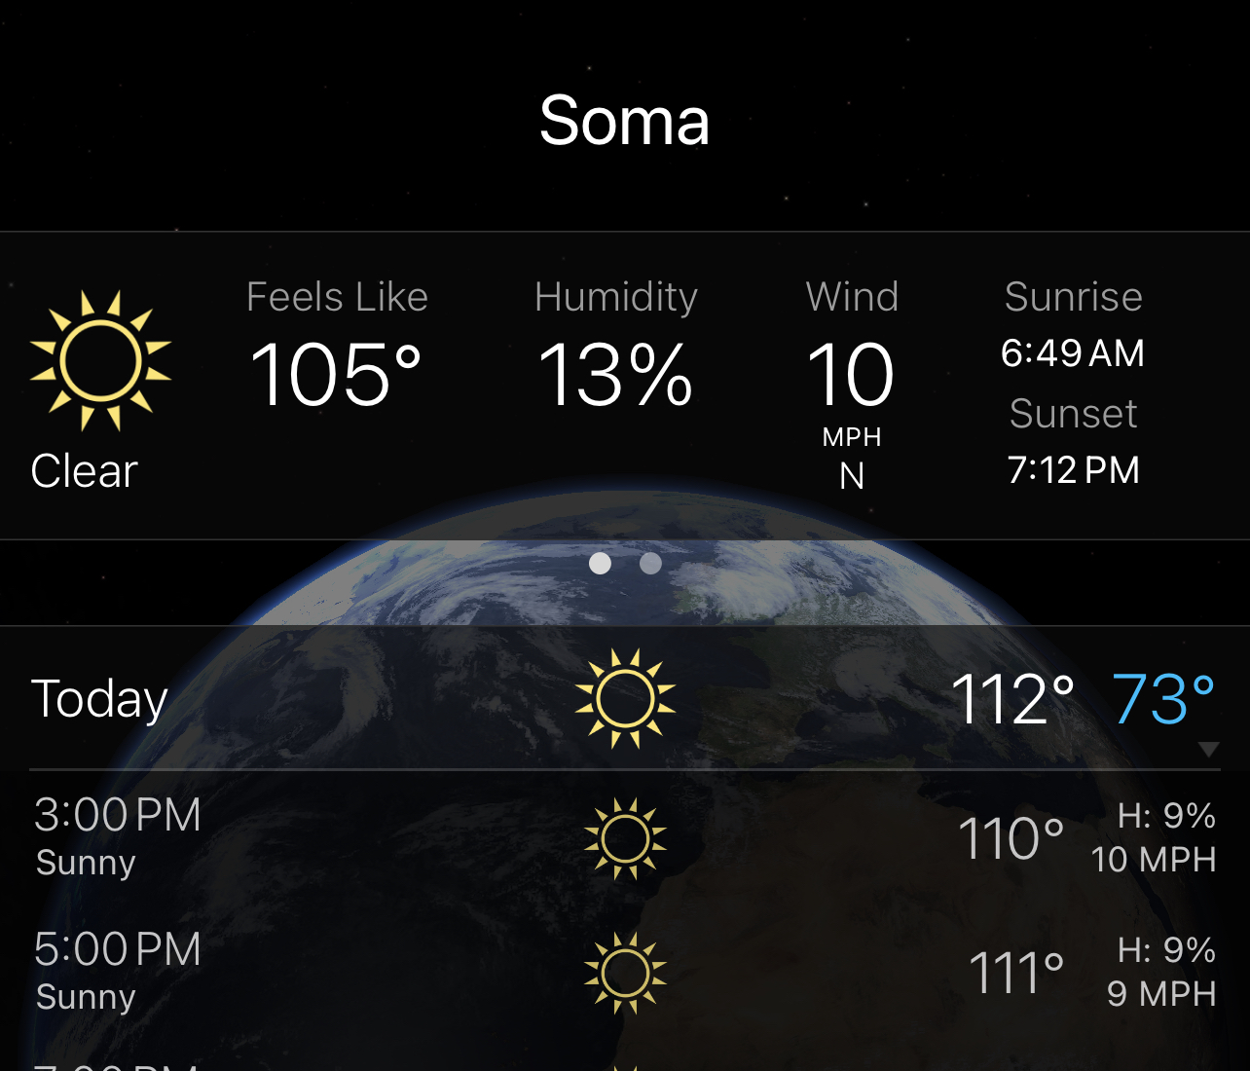
It was hot

Slide 23
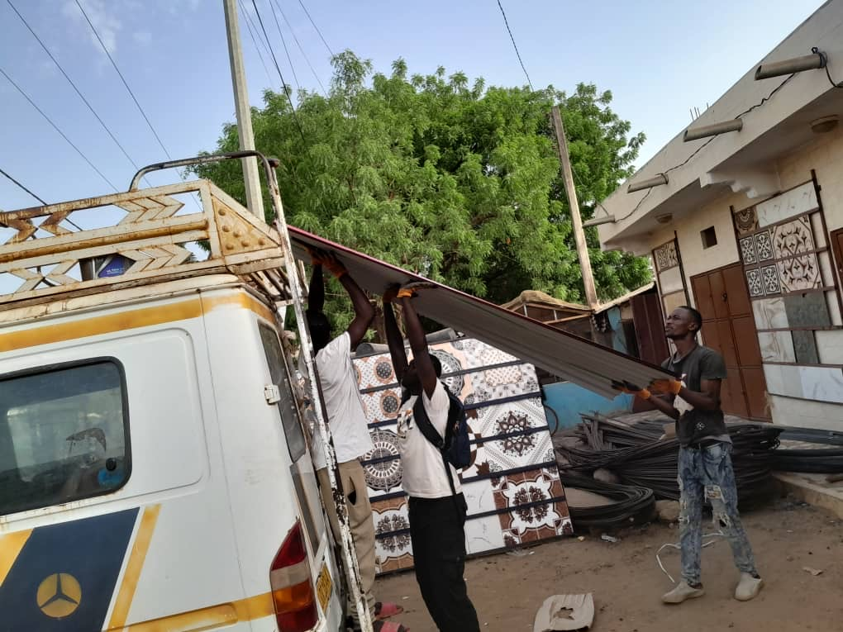
Materials came on bush taxi roofs

Slide 24
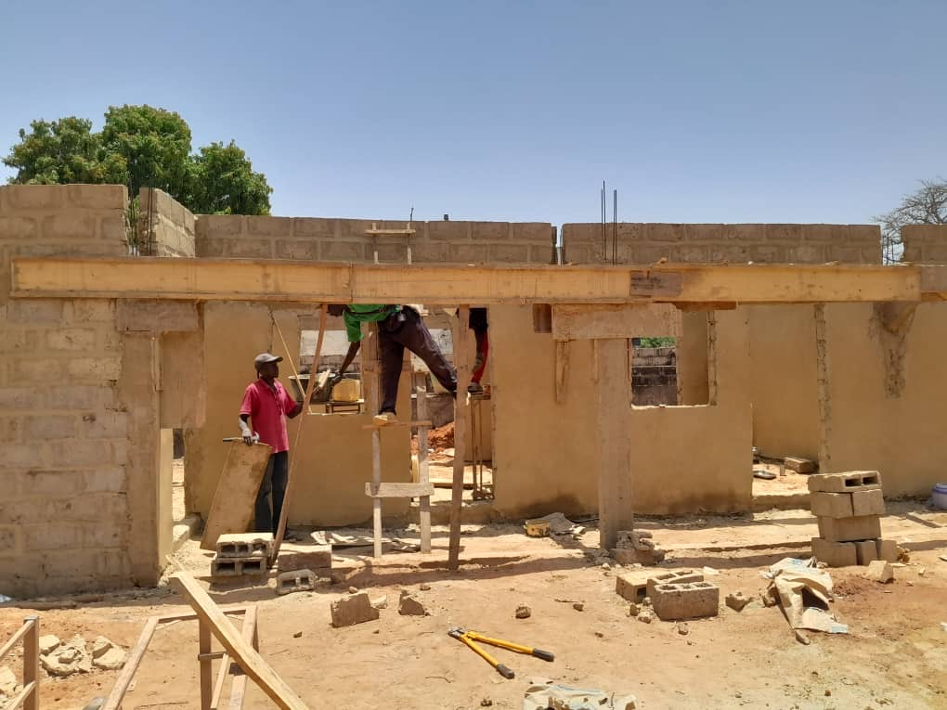

Slide 25
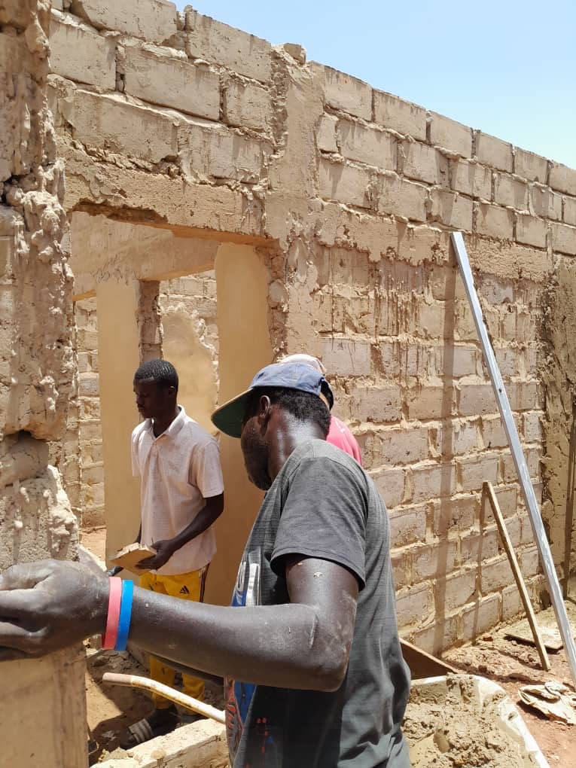

Slide 26
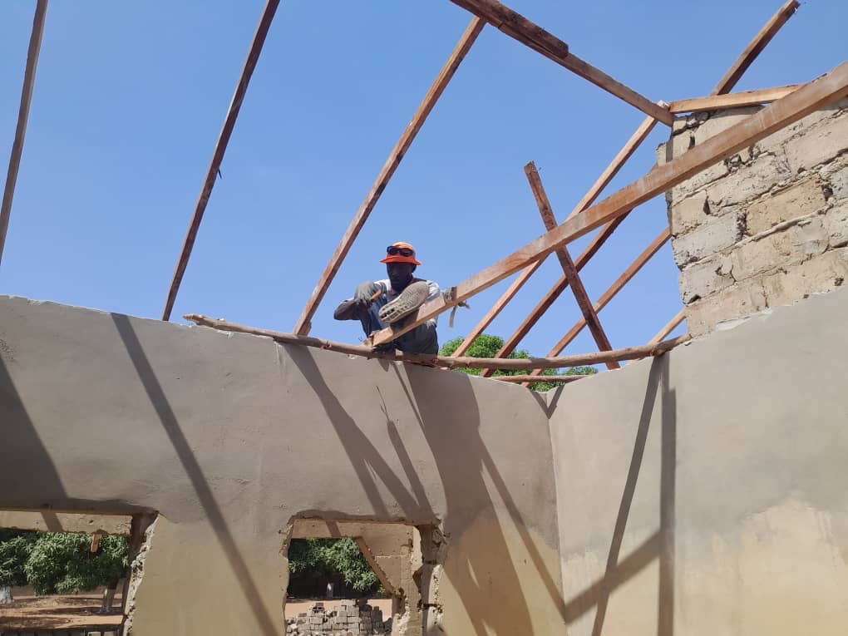

Slide 27
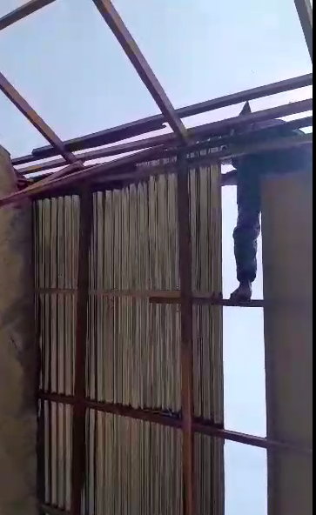

Slide 28
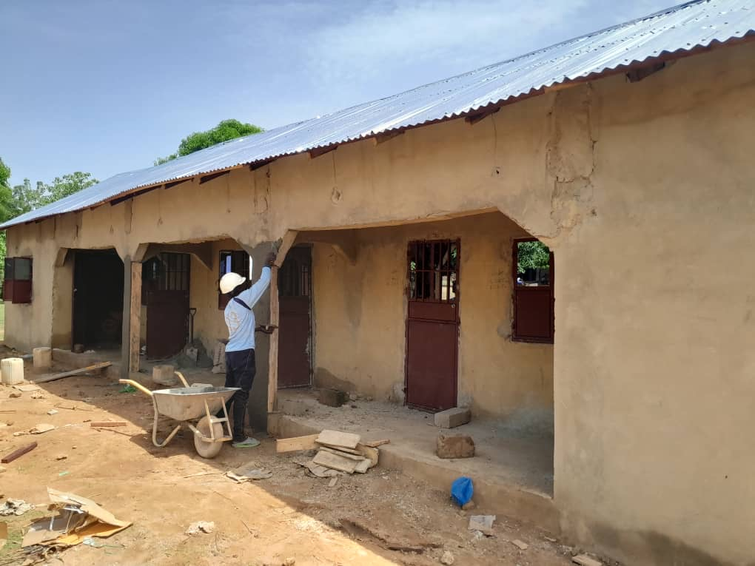

Slide 29
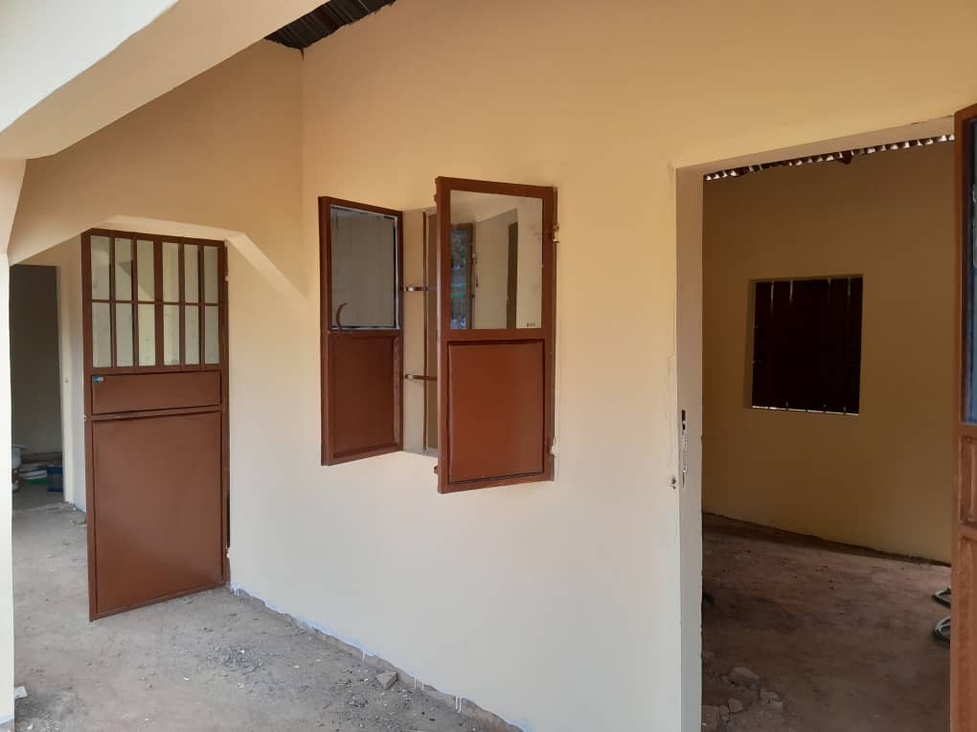

Slide 30
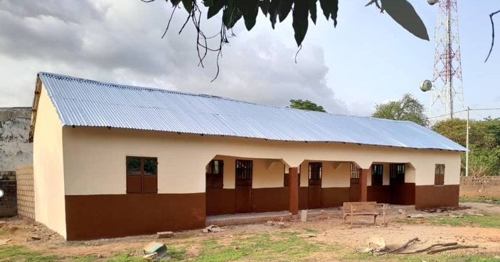

Slide 31
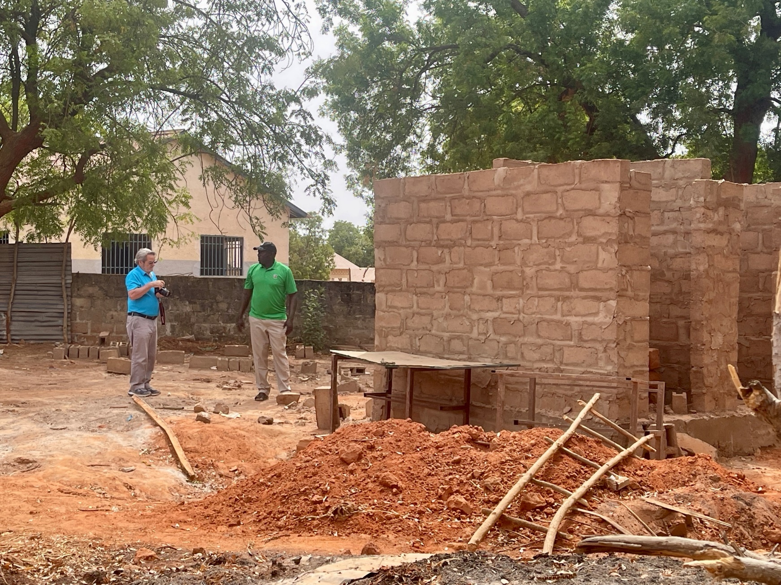
Concord Rotary field inspection

Slide 32
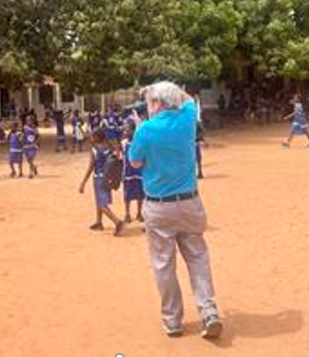

Slide 33
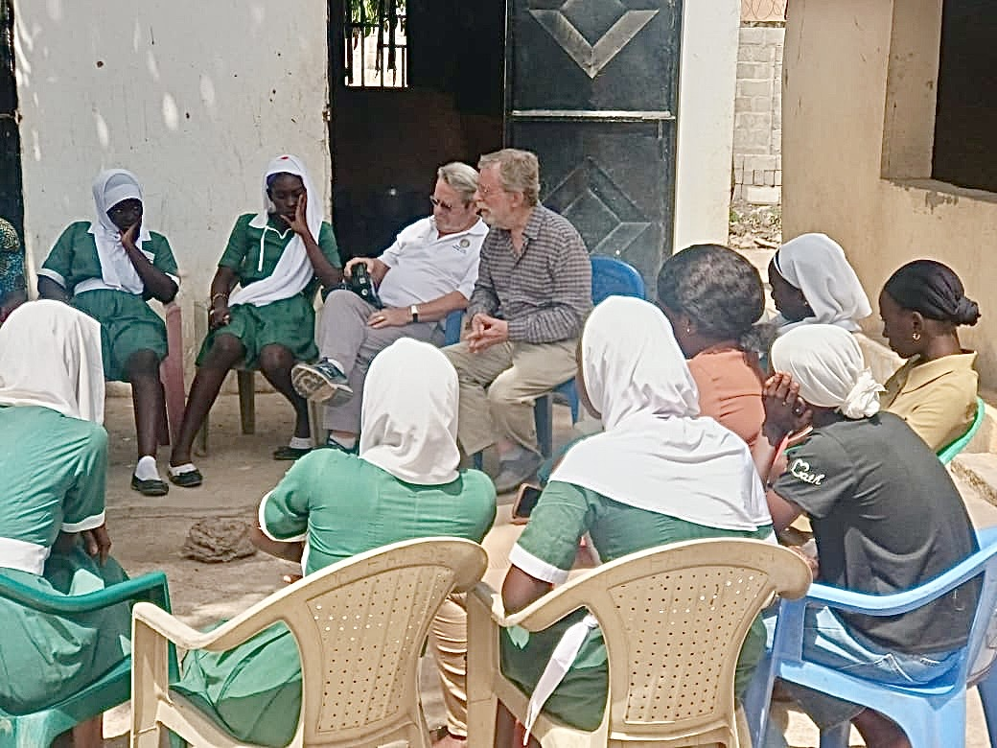

Slide 34
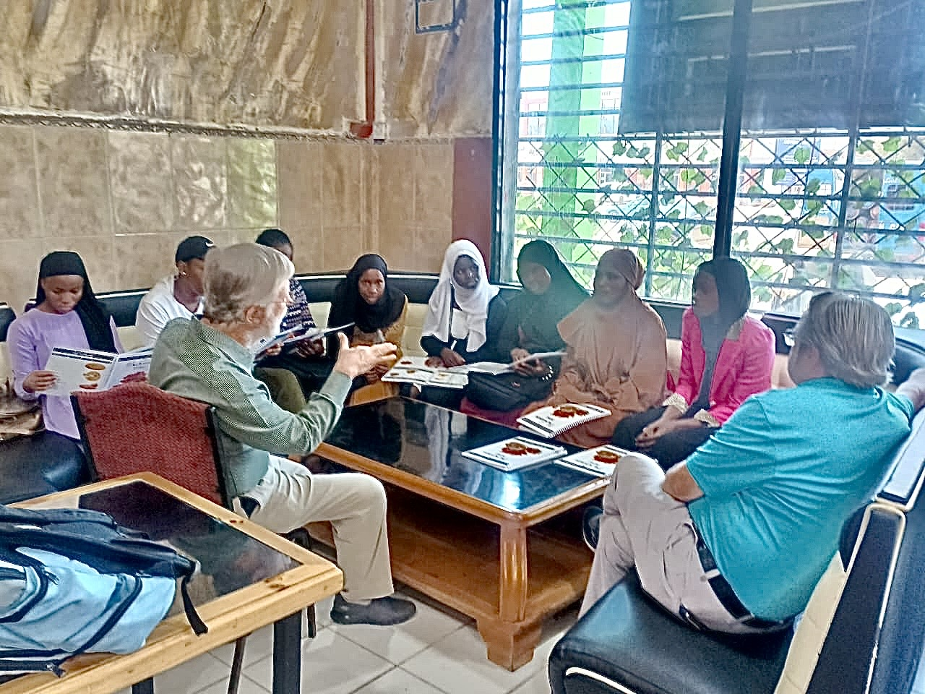
Meeting with college students

Slide 35
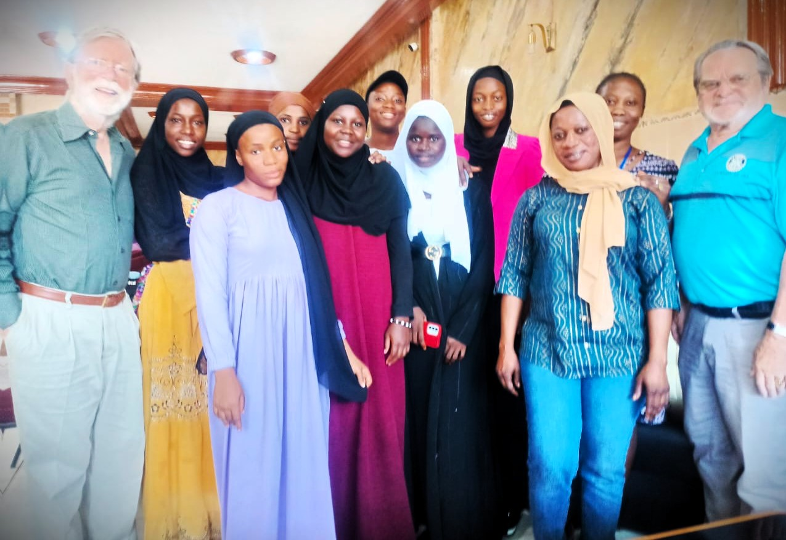

Slide 36
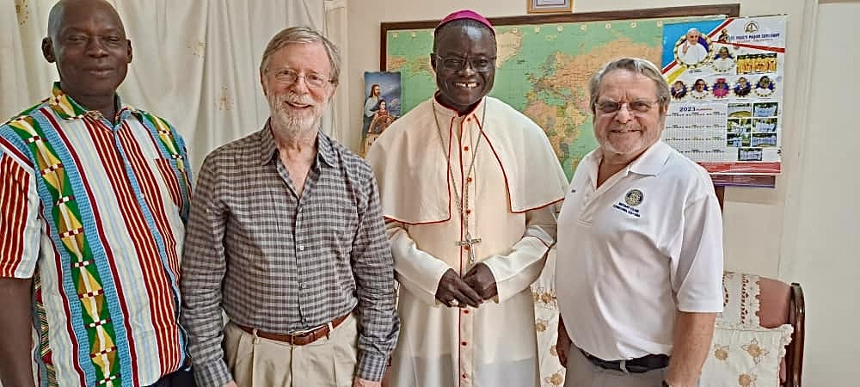
Meeting the Catholic Education Secretary and Bishop of Banjul

Slide 37
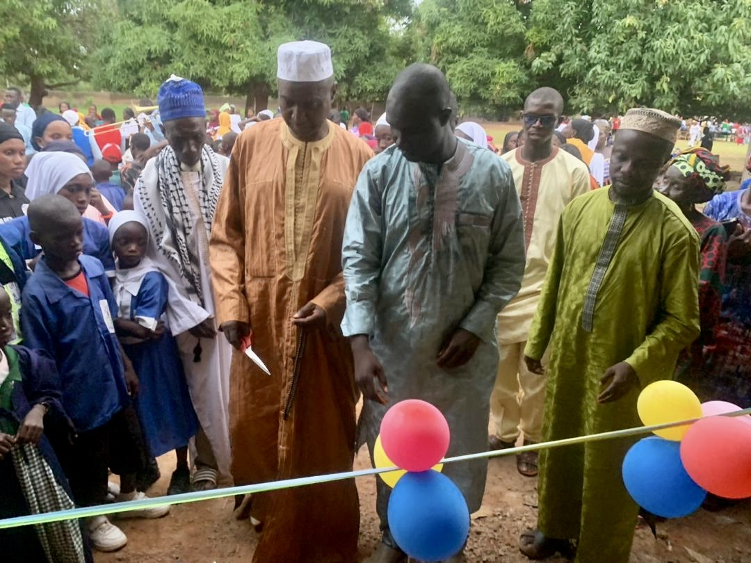
In Massembeh, the village turned out to celebrate completion of the work

Slide 38
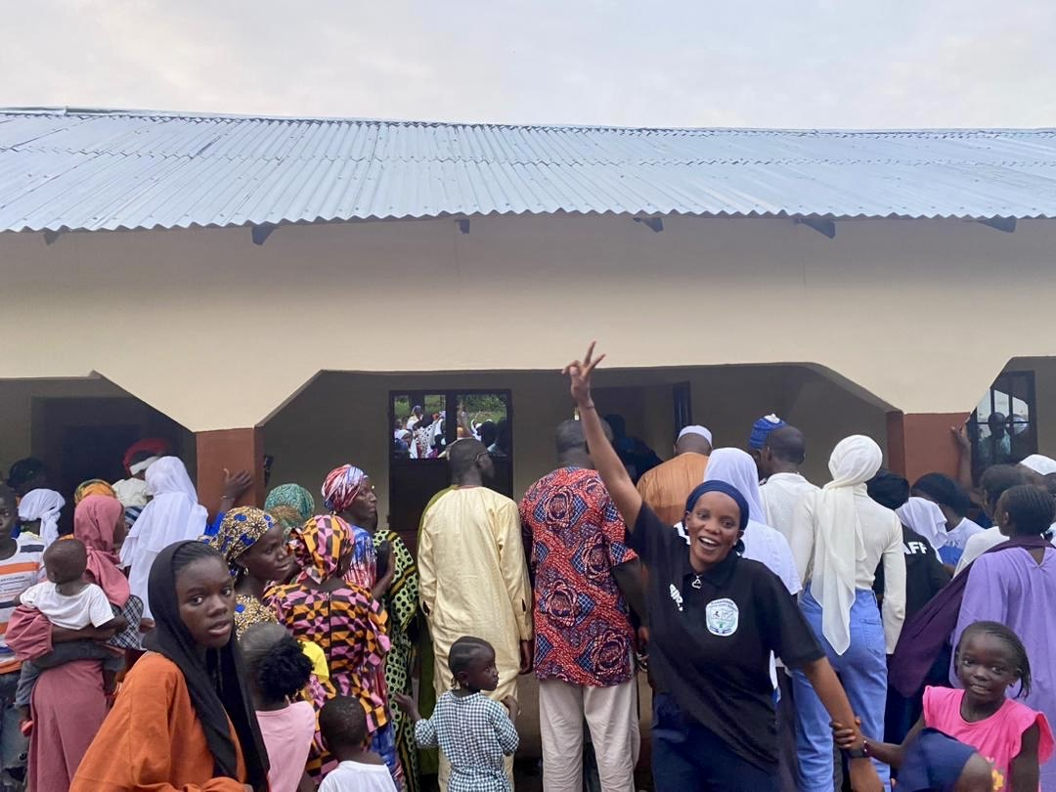

Slide 39
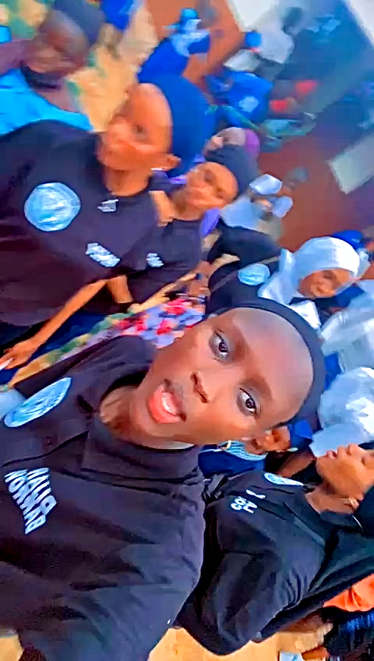
The teachers celebrated most of all

Slide 40
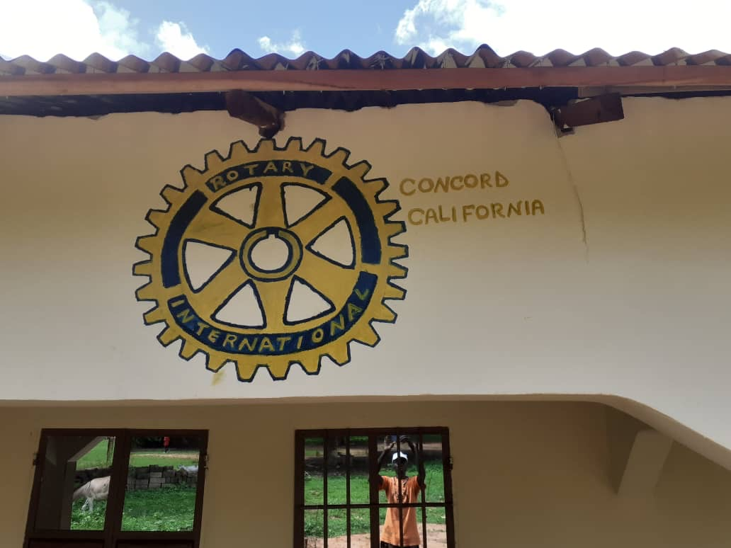
One finishing touch, in gratitude

Slide 41
GambiaRising’s 3-step approach
Keep girls in school through 12th grade
Uniforms, books, supplies
A 12-year commitment
Provide scholarships for girls now in madrassas
Help the best continue to college
Teachers college: 3 years
University: 4 years
Provide housing for upcountry teachers
Women teachers are not only good teachers,
They are also role models for young girls
Ideal for lump-sum project grants
These are perfect for Rotary Club projects
Ongoing maintenance is provided by the schools

Slide 42
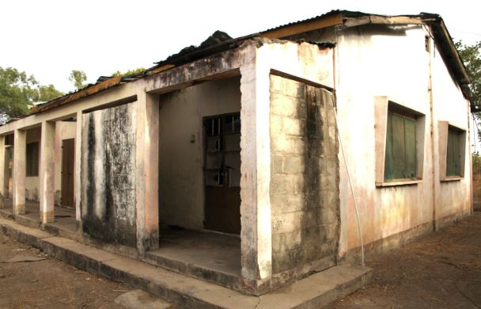
Future Opportunities: Bwiam

Slide 43
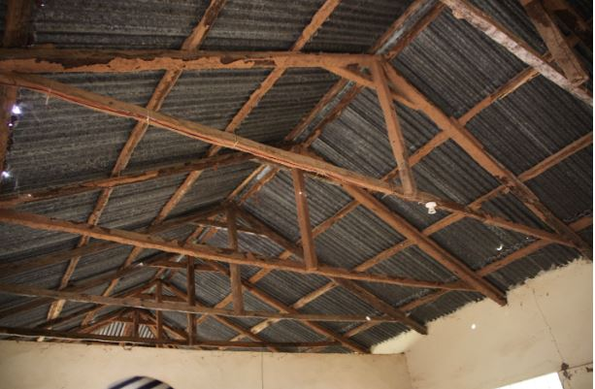

Slide 44
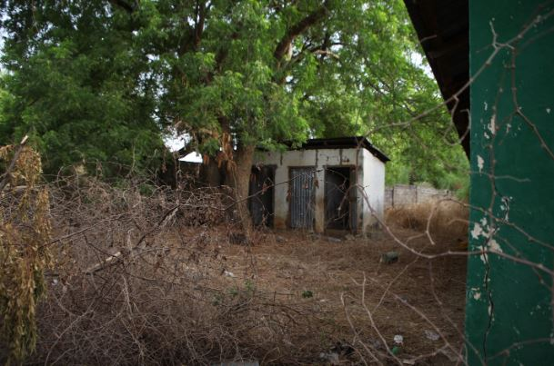

Slide 45
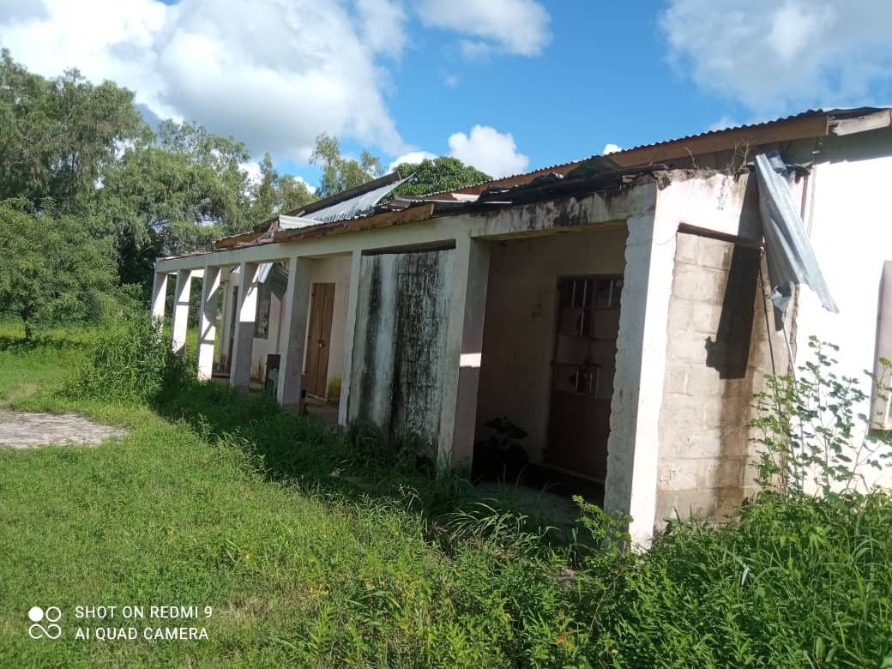
Fula Bantang
Converting abandoned priest’s housing

Slide 46
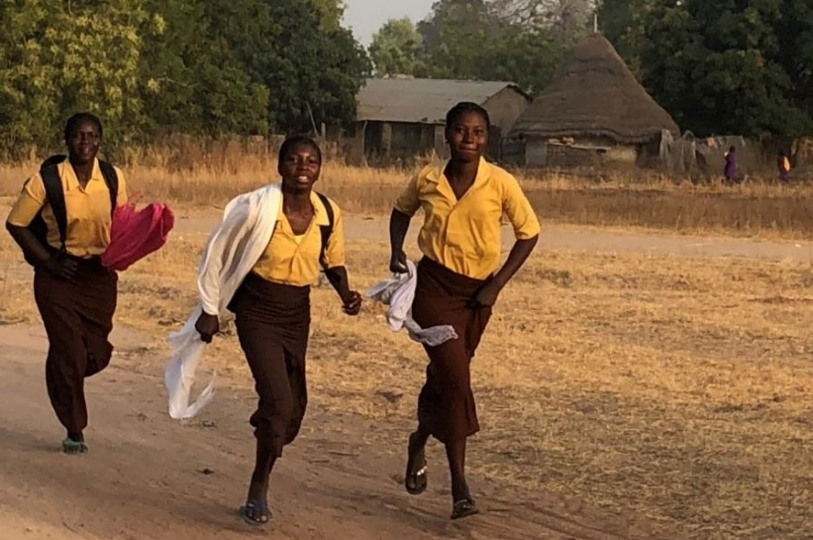
The key to a better future
Educating Girls

Slide 47
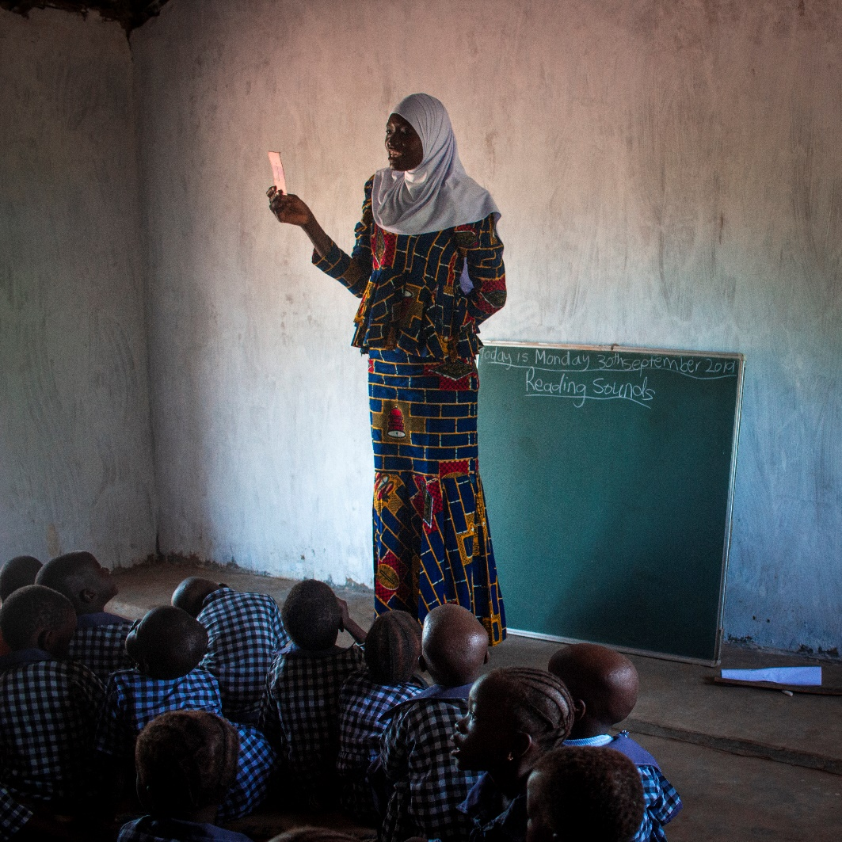
The key to a better future
Supporting rural teachers, especially women

Slide 48
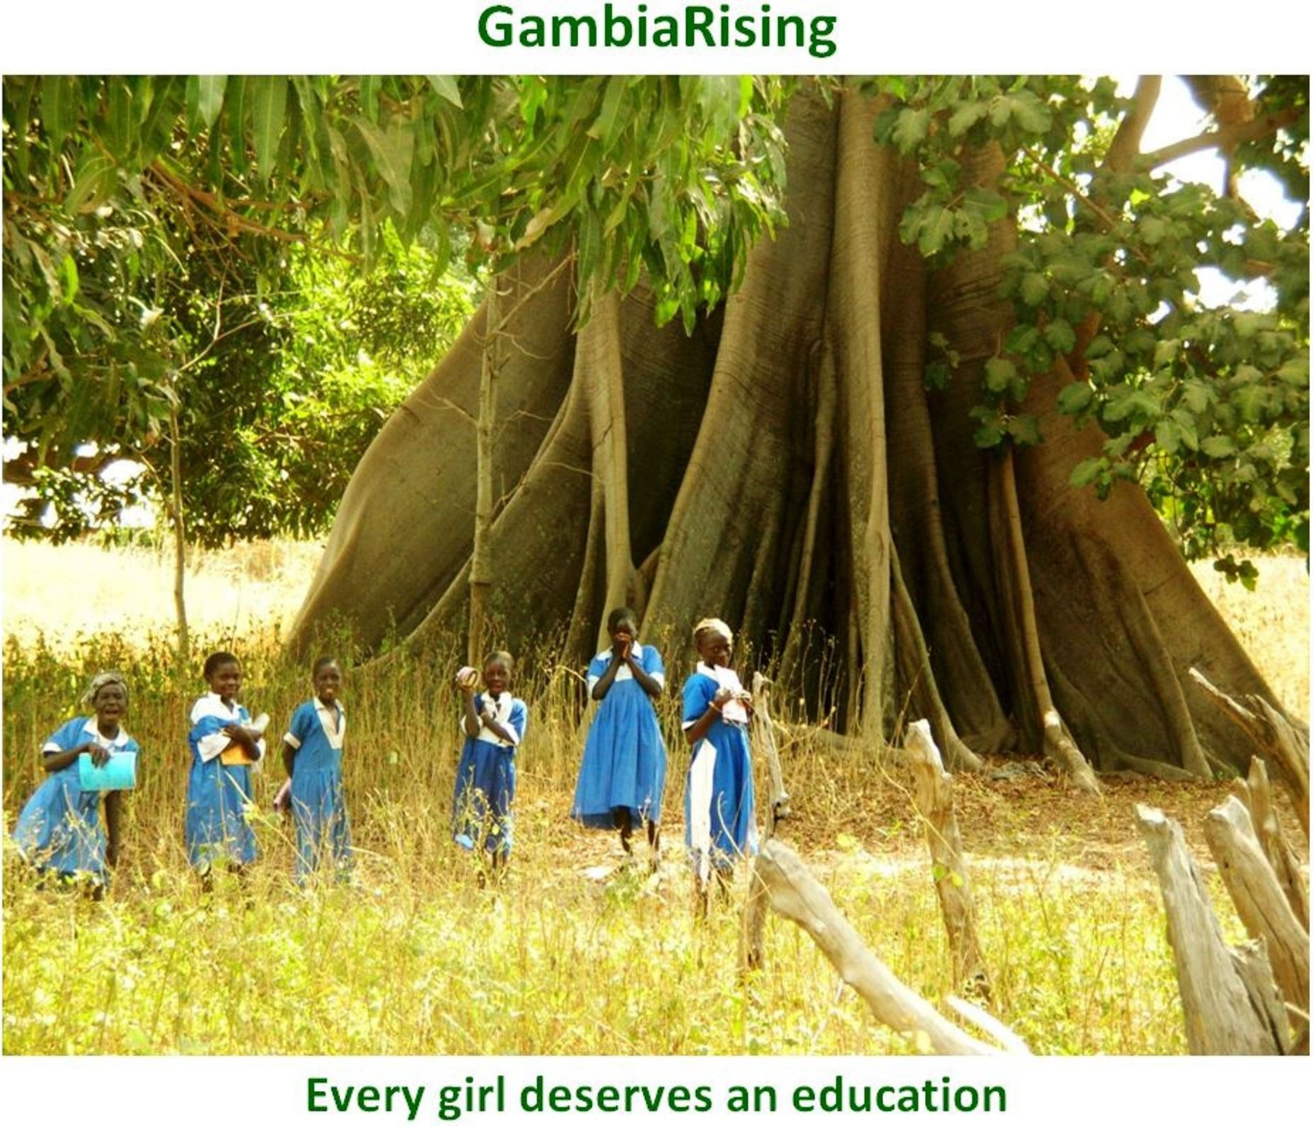

Slide 49


